Slide 1
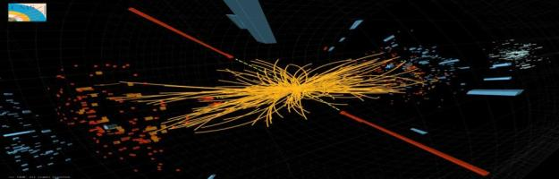

The Second Century of
Particle Physics
Prof. Rich Lebed
September 22, 2012

Slide 2
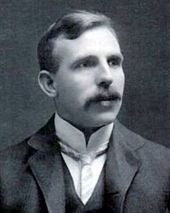

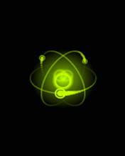
In April, 1911, just over 100 years ago…
This man:
built a remarkable model based upon his experimental results:
Ernest Rutherford,
the nuclear model of the atom

Slide 3
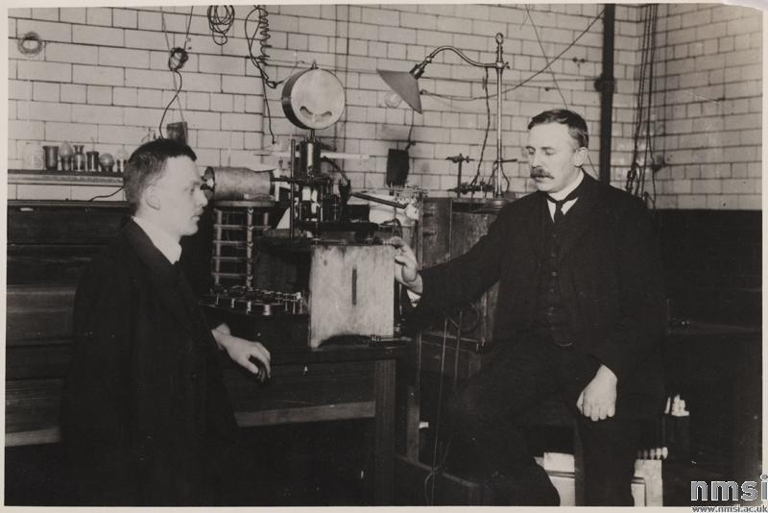
“Tabletop” Particle Physics
Rutherford
Hans Geiger
Radioactive
Particle source
Table

Slide 4
The Large Hadron Collider:
Not very tabletop
Sorry, we had to delete the video!

Slide 5
Particle Physics Prehistory:
Up to 1911

Slide 6
What was known about the physics of the very small just 100 years ago?
19th Century chemistry: Chemical compounds appear to consist of fundamental “elements” combined in integer proportions (e.g., water is H₂O, ammonia is NH₃)
  Simplest explanation: Elements exist in basic units called atoms
19th Century spectroscopy: Very hot gases absorb and emit light only at certain frequencies
  Simplest explanation: Atoms have structure
19th Century electrolysis: Electric current pulls charges out of chemicals
  Simplest explanation: Atoms have charged components
1897: J.J. Thomson discovers that atoms contain very small particles that carry its negative charge, which he names electrons
  Even then, there were still serious scientists who did not believe in atoms until this phenomenon was explained:

Slide 7
Brownian motion:
Indisputable evidence for the existence of atoms
Another deleted video

Slide 8
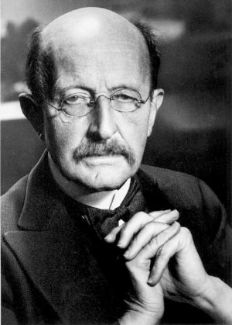
In a seemingly unrelated development…
Max Planck
In 1900, I solved the blackbody problem, which is just the very old question of why hot objects glow, like the surface of the sun or a piece of red-hot metal.
To do it, though, I had to resort to an act of desperation: I had to assume that light only occurs in discrete packets called quanta.
E = hν

Slide 9
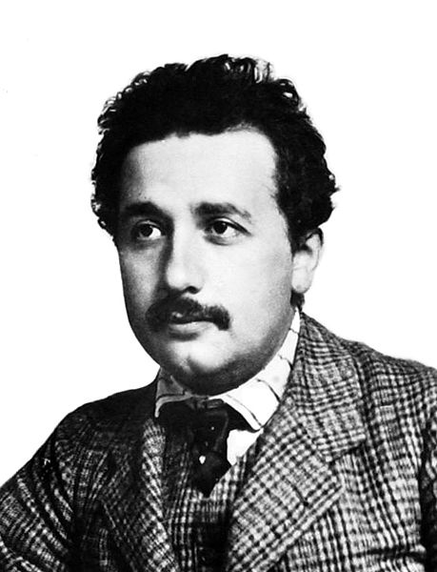
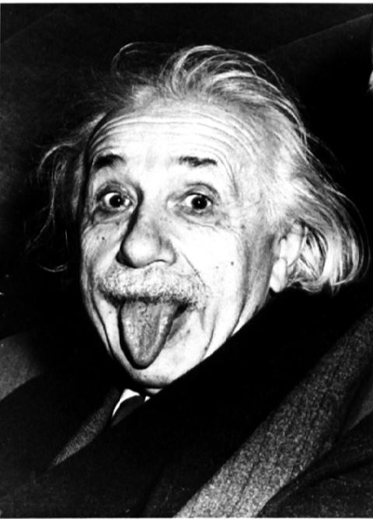
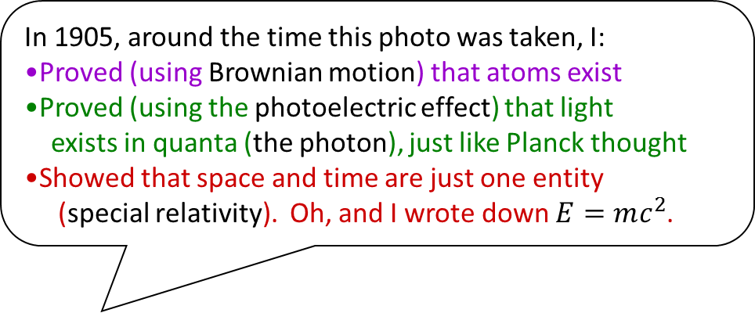
In 1905, around the time this photo was taken, I:
Proved (using Brownian motion) that atoms exist
Proved (using the photoelectric effect) that light
exists in quanta (the photon), just like Planck thought
Showed that space and time are just one entity
(special relativity). Oh, and I wrote down $E=mc^{2}$.
That was a good year. Now I’ll take some time to show that gravity curves space (general relativity). Then maybe I’ll let my hair grow.

Slide 10
Particle Physics
The First Century: 1911-2010

Slide 11
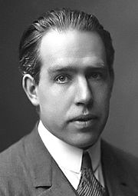
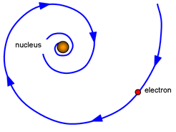
Rutherford’s nuclear model is great except for one thing: Electrons moving in orbits accelerate, and accelerating charges lose energy. Atoms would collapse!
Niels Bohr
In 1913, I applied Planck and Einstein’s quantum ideas to atoms: Electrons can only occur in special discrete (quantized) orbits.

Slide 12
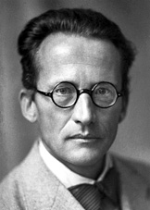
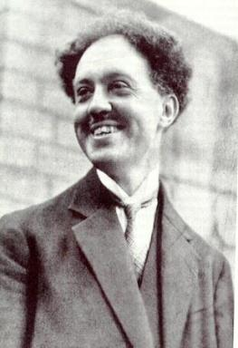
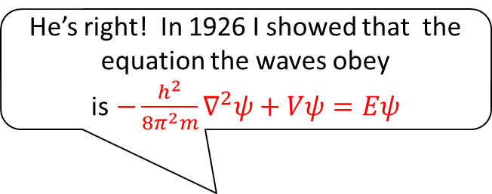
The Quantum Mechanical Wave
Planck and Einstein say that light (a wave) can act like a particle. In 1924, I said that Bohr’s electrons (particles) can act like waves!
He’s right! In 1926 I showed that the equation the waves obey is$−\frac{h^{2}}{8π^{2}m}∇^{2}ψ+Vψ=Eψ$
Louis de Broglie
Erwin Schrödinger

Slide 13
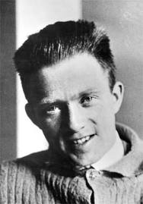
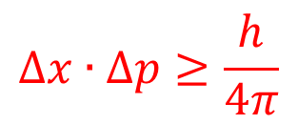
Certain about uncertainty
Not so fast! Yes, particles behave like waves, but observing them causes the wave to collapse into particle form. You lose information just by “looking”!
In 1927, I showed that there is an intrinsic uncertainty to how precisely one can simultaneously measure the position and momentum of a particle
$$Δx∙∆p≥\frac{h}{4π}$$
Werner Heisenberg

Slide 14
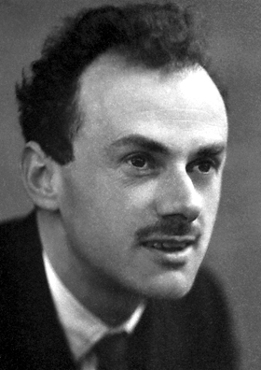
Mirror Mirror
When I combined the Schrödinger equation with Einstein’s relativity in 1927, something strange happened: The equation has both energy
E > 0 and E < 0 solutions. The E < 0 ones make no sense, but I can’t justify ignoring them.
If the E > 0 ones are electrons, then the E < 0 ones would look just like them but have the opposite charge. They are called positrons, and are the first example of antimatter
Moreover, matter and antimatter can be created and destroyed all the time, unlike the Schrödinger equation, which considers only one particle at a time. By the early 1930’s, I had generalized quantum mechanics to quantum field theory
Paul Dirac

Slide 15
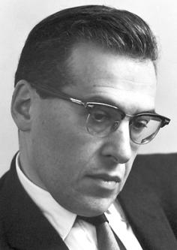
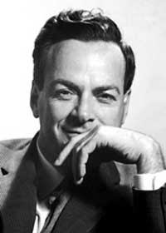
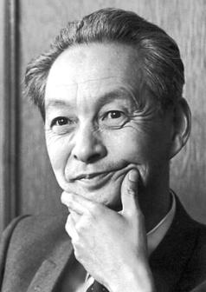
Quantum field theory is still the mathematical formalism in which particle physics calculations are performed…
Dirac: But I keep getting infinite results for almost everything I compute!
1946-1949: The infinities can be eliminated by absorbing them into physical
parameters like the mass and charge: Renormalization
Julian Schwinger
Richard Feynman
Sin-Itiro Tomonaga

Slide 16
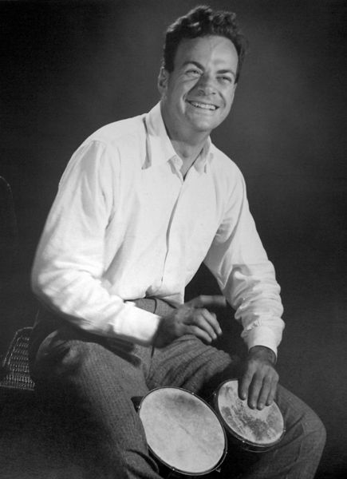
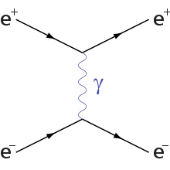
All three of us shared the Nobel Prize…
…but I invented the coolest pictures to show what was going on.
WIN
Feynman
diagrams

Slide 17
Where did the ideas for all of those particles I hear about come from?

Slide 18
The Four Fundamental Forces
Gravity
Electricity and magnetism
The strong nuclear force
  What keeps the positively charged protons,
  which are squeezed so close together inside the nucleus,
  from repelling each other and flying apart?
The weak nuclear force
  How can a particle decay into other particles that weren’t component parts of it in the first place?
  Example: β decay is a common form of radioactivity, in which a nucleus produces an electron and a neutrino that were not present inside of it beforehand. It is an example of the weak interaction

Slide 19
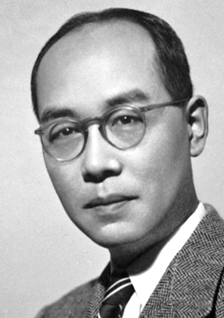
What holds the nucleus together?
In 1935, I had the first good explanation:
Protons and neutrons are bound together by exchanging lighter particles called mesons. Using the size of the nucleus (~10⁻¹⁵ meters), I could even predict their mass!
After my prediction, they discovered a meson, the π (“pion”), at just the right mass!
But then they found another...and another...and another...
Hideki Yukawa

Slide 20
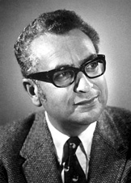
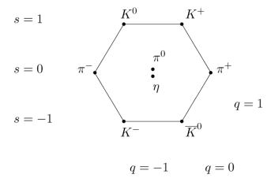
The “Eightfold Way”
In 1961, I showed that not only mesons, but also protons and neutrons and any other particles that feel the strong force can be collected in pretty multiplets according to their charges and masses.
Murray Gell-Mann

Slide 21
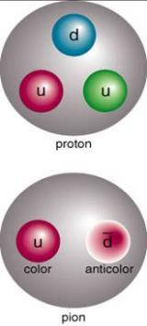
“Three quarks for Muster Mark!”
-James Joyce
By 1964, I realized that these multiplets occur because every strongly-interacting particle is made of quarks

Slide 22
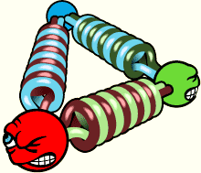
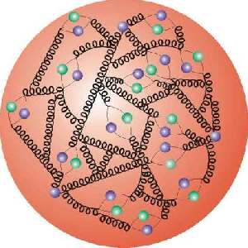
Quantum Chromodynamics (QCD)
In the same way that electricity and magnetism are caused by electric charges exchanging photons, at the deepest level the strong force comes from quarks exchanging a kind of charge called color, which comes in 3 types: red, blue, green.
gluons
No, it doesn’t have anything to do with ordinary colors. But it acts like a glue so strong that it keeps us from ever being separated and seen alone. We live in a state of confinement.
A more realistic picture of a proton

Slide 23
Unsolved issues of strong interactions
No one knows why color charge (and, by extension, quarks and gluons) are confined
No one knows why there are exactly 3 color charges
  In fact, we believe that the universe would be very similar if there were not 3, but some larger number N_{C} of colors
No one knows how a proton is put together out of the three original quarks, lots of quark/antiquark pairs, and all that glue
No one knows if the matter in the interior of a proton is the only way that quarks and gluons can be put together
  For example, steam and ice are two very different phases of water.
  Maybe QCD has several phases?

Slide 24
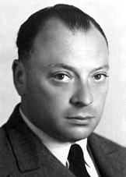
About those weak interactions:
What are neutrinos?
The β decay process with just an electron didn’t make sense. It didn’t conserve energy or angular momentum.
So in 1930, I invented a new particle, the neutrino, which is electrically neutral, very light, and barely interacts at all!
I told my scientific friends about it in a letter that began,
“Dear Radioactive Ladies and Gentlemen,”
Wolfgang Pauli

Slide 25
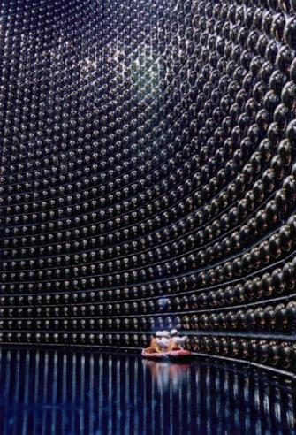
The ultimate in stealth technology
Neutrinos (ν’s) could pass through a light year of solid lead before having much probability of being stopped
The chain of nuclear fusion processes in the sun that make light include β processes that make ν’s. Trillions of them pass right through you every second
So you have to work really hard to catch even a few:
The SuperKamiokande experiment →

Slide 26
What causes weak interactions?
The basic β process is a neutron decaying into a proton, an electron, and a neutrino (n → p e ν)
n and p differ only by the types (flavors) of quark in them, called up (u) and down (d). n is udd and p is uud
We see that weak interactions can cause a quark to change flavor, in this case from d → u
The result of many good ideas (like Yukawa’s) and many hard experiments over the course of decades teaches us that such changes (creating e + ν or changing d → u) are caused by exchanging a very heavy force-carrying charged particle called the W
Just as photons (quanta of light) are the carriers of electricity and magnetism, and gluons are the carriers of the color force, weak interactions are carried by the W and a neutral heavy partner called Z

Slide 27
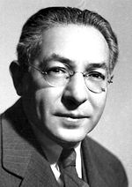
Who ordered that?
Fundamental particles that are neither quarks, nor force carriers, do not participate in strong interactions
Such particles are called leptons, and include e and ν
In fact, the universe could have worked pretty well with just e and ν being the only leptons, and u and d (which make up p, n, and π) being the only quarks
But in 1936, a new charged particle was found in cosmic rays
  Gradually it was realized that this muon (μ) acted just like an electron (it is another lepton), but 200 times heavier
  It seemed to have no particular role, except to be redundant
I, Isidor Rabi, discovered the science that led to magnetic resonance imaging in the late 1930’s, so I felt entitled to ask about the muon:

Slide 28
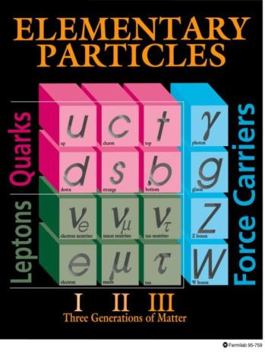
Standard Model: Generations
We now know that all the quarks and leptons have redundant partners:
They all appear in triplicate: 3 generations
Why this happens is one of the great unsolved mysteries of particle physics
Notice also that there are three kinds of neutrino; the one we talked about before was just ν_{e}
One of the most exciting discoveries of the past 15 years is that the three types of ν’s can turn into each other as they travel from production to detection

Slide 29
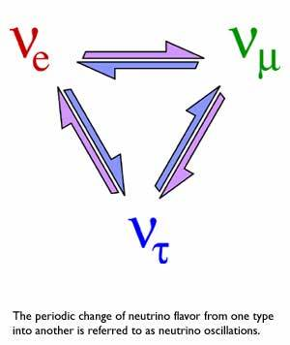
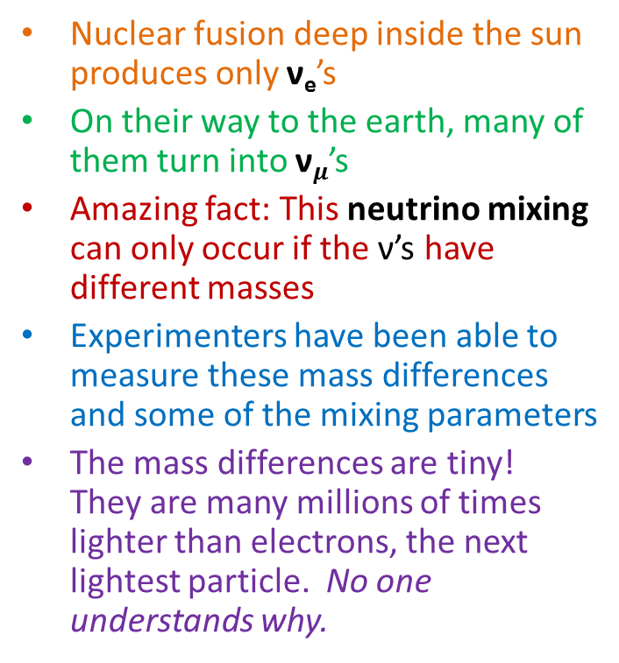
Neutrino masses and mixing
Nuclear fusion deep inside the sun produces only ν_{e}’s
On their way to the earth, many of them turn into ν$μ$’s
Amazing fact: This neutrino mixing can only occur if the ν’s have different masses
Experimenters have been able to measure these mass differences and some of the mixing parameters
The mass differences are tiny! They are many millions of times lighter than electrons, the next lightest particle. No one understands why.
ν

Slide 30
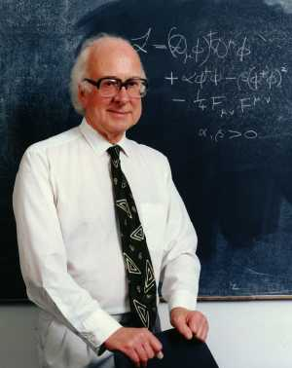
The Standard Model I
We have now met every force carrier and every particle in the Standard Model of electromagnetic, weak, and strong interactions
HEY! Didn’t you forget something important?
It turns out that you can’t make force carriers like W and Z heavy without messing up the quantum field theory…
…unless you put in an extra field that assumes the same finite value everywhere in empty space . This is now called the Higgs mechanism.
Peter Higgs

Slide 31
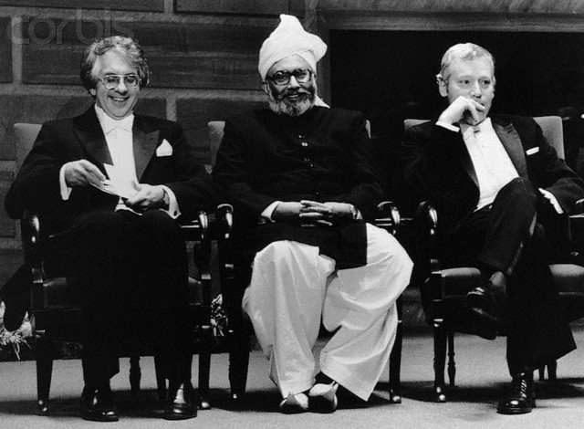
Standard Model II
We were the ones who put it all together in the late 1960’s, by combining electromagnetic and weak interactions into electroweak theory.
The Higgs mechanism applied to the electroweak theory leaves one particle left over to find, called the Higgs
I wonder if it’s over there?
Sheldon Glashow Abdus Salam Steven Weinberg

Slide 32
Particle Physics
The Second Century: 2011-2110

Slide 33
“Around the dawn of the 2nd Century, the Large Hadron Collider began taking data”
The largest scientific project ever constructed (cost over $10 billion), it requires the cooperative effort of many countries
2008, 10 September: First beams
2008, 19 September: Magnets fail! Emergency shutdown
2009, 23 November: First collisions detected
2009, 30 November: LHC becomes highest-energy accelerator in the world
2010, 30 March: Beams reach full strength, 7 TeV
The LHC ran at full steam until the end of 2011;
after a controlled shutdown to perform scheduled maintenance, the beam came back to full strength in April, 2012

Slide 34
What’s the Large Hadron Collider for?
Is it all that they are doing, to find one particle, the Higgs?
That’s just the simplest possible way for the Higgs mechanism to produce the electroweak theory. Many others exist:
  Extra Higgs multiplets: If one, why not more than one?
  Supersymmetry: Every quark and lepton has a partner that looks like a force carrier or Higgs, and vice versa (“squark”, “Higgsino”, etc.)
  Large, curled up extra spacetime dimensions beyond the 4 we know
  Extra strong interactions that look like ones we know: Technicolor
  Extra particles that, for very short amounts of time, violate cause and effect: Lee-Wick theories
  Something that nobody has yet dreamed up

Slide 35
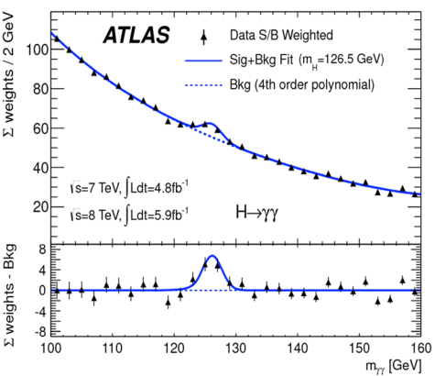
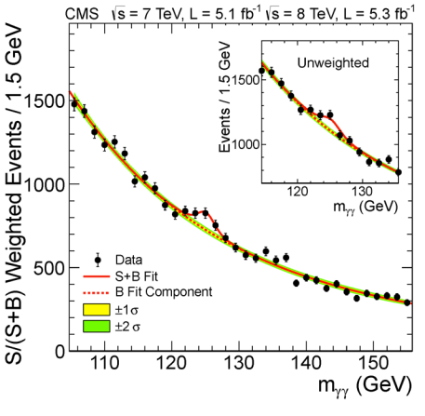
7/4/12: LHC announces the discovery of a new particle in just the right place
And both big experiments (ATLAS, CMS) see exactly the same thing.
Is it really “the” Higgs? Could there be more? Experiments underway are characterize whether this new particle has precisely the right properties.

Slide 36
What else might the LHC teach us?
Have you noticed that there’s not much antimatter lying around? Almost everything in the universe seems to be made of matter
But quantum field theory tells us to expect matter and antimatter in roughly equal amounts
The Standard Model does have a way to distinguish them, but it seems to be way too small to explain the ubiquity of matter
However, lots of theories beyond the Standard Model (BSM) naturally incorporate new ways to represent this matter-antimatter asymmetry
The LHC might uncover evidence for one of these new BSM theories; for example, something they find might be a form of the cryptic dark matter of the universe

Slide 37
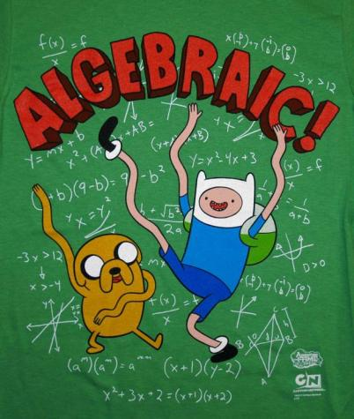
While the LHC is important, after its run many fundamental, deep, and exciting questions will remained to be answered

Slide 38
How many fundamental forces are there, really?
Electroweak unification shows that electromagnetic and weak forces are really just two aspects of the same interaction.
Do strong forces unify with electroweak ones?
  If they do, then quarks and leptons become much more closely related particles; it would explain why quarks have just the right electric charges to give protons charge equal and opposite to that of electrons
  If they do, it must occur at an energy about 10¹² times that of the LHC
  If they do, then protons themselves could decay, making atoms unstable. But atoms appear to be very stable! Protons would have to have a very long lifetime, 10³⁴ years or more
  If they do, the resulting theory is called a grand unified theory

Slide 39

What about gravity?
The one force for which we don’t possess a quantum field theory is gravity, because it is much weaker even than the weak force. We don’t know if it even has one, or what (if anything) it has to do with the hidden dark energy of the universe.
We all know the answer is string theory, and I’m going to be the one to prove it.
You wish. String theories don’t make hard predictions that can be proved or disproved by experiments.
Gravity is so super-weak that it only becomes important at energies 10¹⁶ times
that of electroweak physics and the Higgs. No one knows why.
This is called the hierarchy problem.

Slide 40
The grand challenges of the 2nd Century
How does the Higgs mechanism work in detail?
How is the hierarchy problem among interactions resolved?
Why is there a matter-antimatter asymmetry in the universe?
Why do quarks confine?
What are the phases of strongly interacting matter?
Why do neutrinos have tiny masses and mix with each other?
Why does the Standard Model have 3 particle generations?
Can we build a better experiment than the LHC? Can anyone afford a bigger accelerator, or do we need a new technology?
How can we show if grand unification occurs?
What are dark matter and dark energy?
How does gravity combine with quantum mechanics? Is string theory real and testable?

Slide 41

What will we know in 2111?
One of your students could perform an experiment at the upgraded super-high energy LHC that will form their Ph.D. thesis in 2022, and discover that the new dark matter particles have unexpected interactions that point to a new fundamental force, neither strong nor electroweak
One of your children could discover in 2045 based on data from a deep underground lab that the ultimate source of neutrino masses is also responsible for the matter-antimatter asymmetry of the universe
One of your grandchildren in 2070 could write down the field equations that unify gravity with the other interactions. It isn’t quite string theory, but she explains in her Nobel Prize acceptance speech how that old-fashioned theory got her interested in the problem

